Slide 1
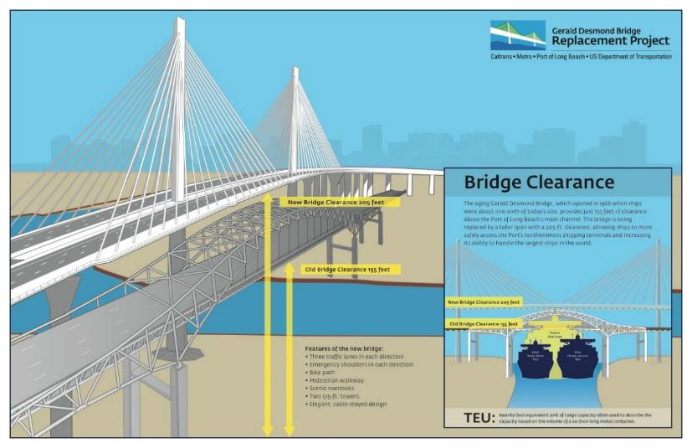
Port of Long Beach
Gerald Desmond Bridge Replacement Project Old/New Bridge Clearance Comparison Info Graphic
Visual-only Presentations

